Slide 1
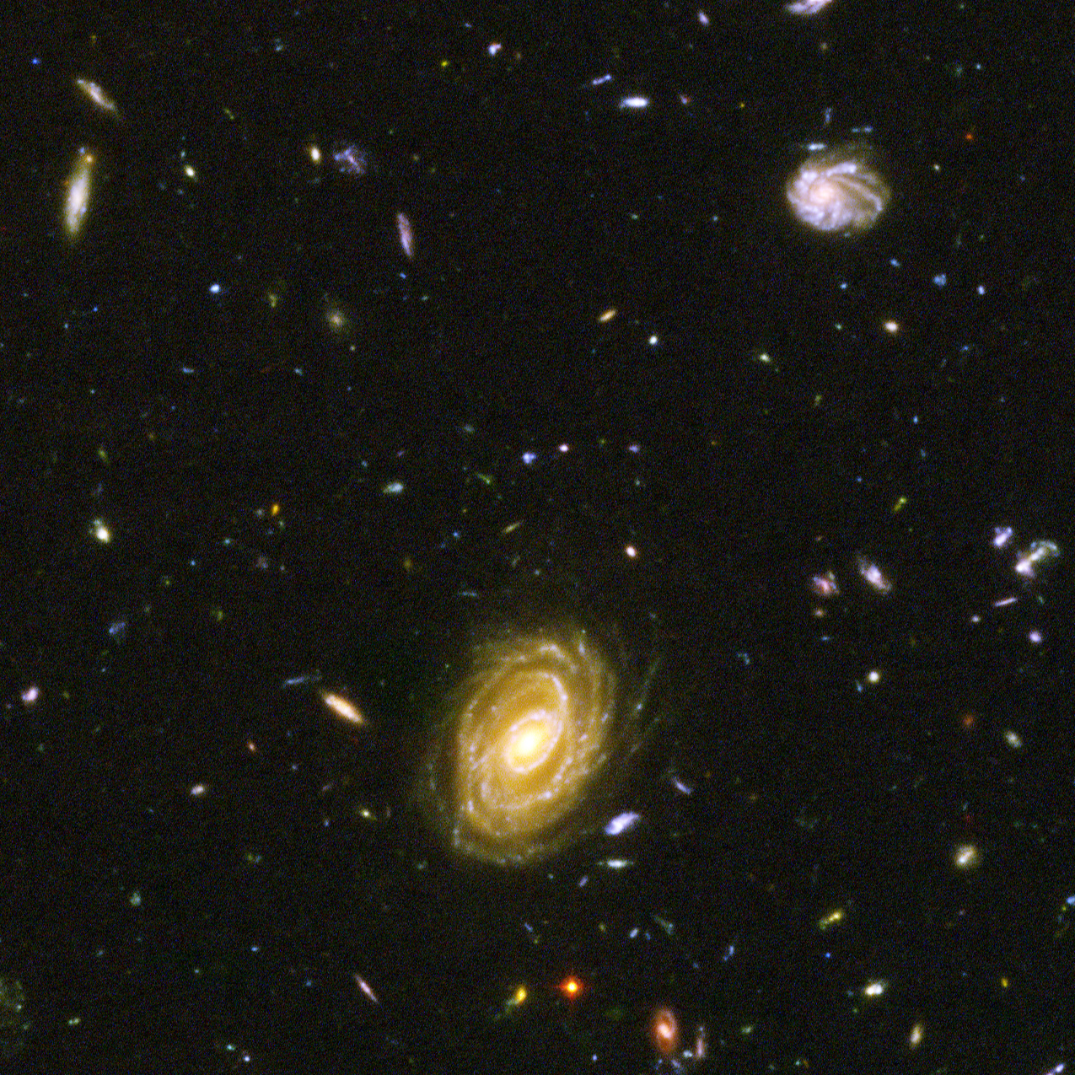
Deduplication in Data Storage Systems
15-minute interim presentation — core concept & experiment plan (Kubernetes/Longhorn)
TU Dresden · Diplom Informatik (PO 2010) · Analysis of a Research Topic
Benjamin-Elias Probst
Notes:
[Sources]
- ESA Hubble Ultra Deep Field image (background): https://www.esa.int/ESA_Multimedia/Images/2005/09/Hubble_s_ACS_close-up_view_of_Hubble_Ultra_Deep_Field (download link used)
[/Sources]

Slide 2
Deduplication — Interim Presentation
15 min
1. Scope
Guiding question
Document evolution (last 3 drafts)
Draft A: theory + taxonomy (dedup vs. compression)
Draft B: cleaned English version + consistent citations
Draft C (current): adds reproducible experiment plan and measurement model
“What is deduplication at the core?”
We operationalize the definition into measurable storage effects: Do byte-identical payloads lead to sub-linear physical storage growth, and where (DB vs. storage layer) does that effect originate?
Today’s structure
Core definition + boundaries vs. compression / SIS
Taxonomy & key milestones (why it works / where it breaks)
Experimental setup on Kubernetes + Longhorn (replica=4)
Workloads, datasets, and metrics (ingest, physical size, reclamation)
Expected observations + next steps
Notes:
[Sources]
- Dedup definition baseline (SNIA): https://www.snia.org/sites/default/files/Understanding_Data_Deduplication_Ratios-20080718.pdf
[/Sources]

Slide 3
Deduplication — Interim Presentation
Core concept
2. Core concept
Deduplication (core): store/transmit only unique chunks
Key idea: detect byte-identical segments and replace repeats with references (sub-file level).
Incoming data
Chunking +
fingerprints
Chunk store
A
A
B
C
B
B
Repeated “B” blocks become references → physical growth slows
when duplicates dominate (if dedup is present).
Index:
hash → location
C
B
If hash already exists → store reference only
Notes:
[Sources]
- SNIA definition of deduplication (sub-file level, unique data only): https://www.snia.org/sites/default/files/Understanding_Data_Deduplication_Ratios-20080718.pdf
[/Sources]

Slide 4
Deduplication — Interim Presentation
Taxonomy
3. Taxonomy
What can “deduplication” mean in practice?
Same word — different design points. Our experiments must separate these dimensions.
Granularity
When
Where
File-level (SIS) vs block/chunk-level; content-defined chunking helps with shifted inserts.
Inline (write-path) vs post-process (background). Trade latency vs. space.
Source-side vs target-side; also DB layer vs storage layer.
Indexing
Workload fit
Security
Full index vs sparse / sampled index; locality-aware caching.
Backups (high redundancy) vs primary workloads (latency, fragmentation constraints).
Encrypted data reduces dedup effectiveness; global dedup can create side-channels.
Notes:
[Sources]
- SNIA on sub-file dedup vs. SIS: https://www.snia.org/sites/default/files/Understanding_Data_Deduplication_Ratios-20080718.pdf
- SNIA overview of SIS + fixed/variable block strategies: https://www.snia.org/educational-library/single-instance-strategies-storage-2007
[/Sources]

Slide 5
Deduplication — Interim Presentation
Milestones
4. Why it works
Milestones that shaped modern deduplication
A quick lineage: similarity detection → content-addressing → high-throughput indexing → primary-storage constraints.
LBFS
(similarity, chunking)
DDFS
(avoid disk bottleneck)
iDedup
(primary-storage safe)
2001
2002
2008
2009
2012
2016
Venti
(content-addressed)
Sparse Indexing
(sample + locality)
FastCDC
(faster CDC)
Takeaway: achieving dedup at scale is an indexing + locality problem; primary workloads add fragmentation/latency constraints.
Notes:
[Sources]
- LBFS (2001): https://www.cis.upenn.edu/~bcpierce/courses/dd/papers/lbfs.pdf
- Venti (FAST 2002): https://www.usenix.org/conference/fast-02/venti-new-approach-archival-data-storage
- Data Domain DDFS (FAST 2008): https://www.usenix.org/conference/fast-08/avoiding-disk-bottleneck-data-domain-deduplication-file-system
- Sparse Indexing (FAST 2009): https://www.usenix.org/event/fast09/tech/full_papers/lillibridge/lillibridge.pdf
- iDedup (FAST 2012): https://www.usenix.org/system/files/conference/fast12/srinivasan.pdf
- FastCDC (ATC 2016): https://www.usenix.org/system/files/conference/atc16/atc16-paper-xia.pdf
[/Sources]

Slide 6
Deduplication — Interim Presentation
Where it lives
5. Where to measure
Where can deduplication actually occur?
Our measurement distinguishes “logical bytes” (reported by the system) from “physical bytes” (Longhorn replicas).
Application / client
Measure both
Logical size (DB/table/topic/bucket counters)
Physical size (Longhorn “actual size” per replica)
Replica factor N=4 → normalize
After deletes: run compaction/vacuum + discard/TRIM
Database engine
(PostgreSQL, MariaDB, ClickHouse, CockroachDB)
Streaming / object systems
(Kafka, MinIO)
Filesystem inside container
Block storage layer (Longhorn)
Node disks (4 workers)
Notes:
[Sources]
- Longhorn concepts (synchronous replication across replicas/nodes): https://longhorn.io/docs/latest/concepts/
- Longhorn metric longhorn_volume_actual_size_bytes: https://longhorn.io/docs/latest/monitoring/metrics/
[/Sources]

Slide 7
Deduplication — Interim Presentation
Experiment setup
6. Testbed
Experimental testbed (Kubernetes + Longhorn)
4 worker nodes · Longhorn StorageClass · per-system PVC = 100 GiB · replica count N=4
Worker 1
Worker 2
Worker 3
Worker 4
DB Pod
DB Pod
DB Pod
DB Pod
Longhorn replica
(blocks)
Longhorn replica
(blocks)
Longhorn replica
(blocks)
Longhorn replica
(blocks)
Each database gets a dedicated Longhorn volume: 100 GiB PVC, replicated synchronously to 4 nodes (N=4).
Notes:
[Sources]
- Longhorn replication across multiple replicas on multiple nodes: https://longhorn.io/docs/latest/concepts/
- Longhorn metric longhorn_volume_actual_size_bytes (actual space used by each replica): https://longhorn.io/docs/latest/monitoring/metrics/
[/Sources]

Slide 8
Deduplication — Interim Presentation
Systems
7. Systems
Systems under test
Goal: compare “classic SQL”, streaming, and object storage behaviors under identical duplication workloads.
Databases
Streaming / Object storage
PostgreSQL (row-store SQL)
MariaDB (row-store SQL; compression options)
ClickHouse (column-store OLAP; heavy compression)
CockroachDB (distributed SQL; replication at DB layer)
Apache Kafka (log segments; delete vs compact policy)
MinIO (S3 object store; explicitly no dedup by design)
Redcomponent-DB (new system — empirical baseline)
Notes:
[Sources]
- ClickHouse academic overview / paper reference: https://clickhouse.com/docs/academic_overview
- CockroachDB SIGMOD paper: https://dl.acm.org/doi/10.1145/3318464.3386134
- Kafka topic config cleanup.policy (delete/compact): https://kafka.apache.org/30/generated/topic_config.html
- Confluent explanation of cleanup.policy and compaction: https://docs.confluent.io/platform/current/installation/configuration/topic-configs.html
- MinIO statement on not implementing deduplication: https://blog.min.io/myths-about-deduplication-and-compression/
[/Sources]

Slide 9

Deduplication — Interim Presentation
Datasets
8. Workloads
Reproducible datasets & payload types
Focus: payloads that can be duplicated byte-identically to isolate deduplication from compression.
Payload families
Structured (SQL-friendly)
• timestamps (monotonic)
• random numerics
• strings / VARCHAR
• UUID (high entropy)
• JSON/JSONB (semi-structured)
Large objects
• Images (NASA)
• Video (Blender Open Movies)
• Full text (Project Gutenberg)
Already available
• GitHub logs · bank transactions · synthetic random numbers
NASA imagery (example)
Open movie (example)
Notes:
[Sources]
- NASA media usage guidelines (reuse): https://www.nasa.gov/nasa-brand-center/images-and-media/
- Hubble Ultra Deep Field image page (ESA): https://www.esa.int/ESA_Multimedia/Images/2005/09/Hubble_s_ACS_close-up_view_of_Hubble_Ultra_Deep_Field
- Big Buck Bunny poster (Wikimedia Commons / Blender Foundation, CC BY): https://upload.wikimedia.org/wikipedia/commons/thumb/c/c5/Big_buck_bunny_poster_big.jpg/1200px-Big_buck_bunny_poster_big.jpg
- Big Buck Bunny licensing info (Commons): https://commons.wikimedia.org/wiki/Big_Buck_Bunny
- Project Gutenberg license/terms: https://www.gutenberg.org/policy/license.html
[/Sources]

Slide 10
Deduplication — Interim Presentation
Procedure
9. Procedure
Experimental procedure (what we will run)
Three stages × three duplication levels (U0/U50/U90) × payload families × systems.
Duplication levels: U0 (unique) · U50 (50% duplicates) · U90 (90% duplicates)
Stage 1
Bulk load
Stage 2
Per-file insert
Stage 3
Per-file delete
“Natural” schema
COPY/LOAD, producer, S3 put
Measure T_bulk + Longhorn size Δ
One file = one row/object/message
Measure latency + throughput
Compute EDR (logical vs physical)
Delete one by one
Run maintenance: vacuum/compaction
Measure size reclamation
Measurements captured at each step
Ingest time / throughput · logical bytes written · Longhorn “actual size” per replica · normalized physical bytes (÷N) · effective dedup ratio (EDR) · post-delete reclamation time/amount
Notes:
[Sources]
- Longhorn metrics (actual size per replica): https://longhorn.io/docs/latest/monitoring/metrics/
- Kafka topic cleanup.policy (delete vs compact): https://kafka.apache.org/30/generated/topic_config.html
[/Sources]

Slide 11
Deduplication — Interim Presentation
Metrics
10. Metrics
How we quantify deduplication vs. “just compression”
We normalize the Longhorn replica footprint and compare it to logical bytes written.
Illustrative expectation (not measured yet)
Primary metric (EDR)
EDR = B_logical / (B_phys / N)
B_logical = sum(payload bytes)
B_phys = Longhorn actual size (sum over replicas)
N = replica count (=4)
Interpretation: EDR ≈ 1 → no dedup (beyond replication/compression). EDR > 1 → storage-layer reuse of identical content.
Critical post-delete note
Block storage does not automatically shrink on deletes. After Stage 3, we must trigger:
• DB maintenance (VACUUM FULL / OPTIMIZE / compaction)
• filesystem discard/TRIM
…otherwise physical size may not reflect reclaimed free space.
If dedup is present: EDR increases with duplication.
If only compression: EDR stays ~flat across U0/U50/U90.
Notes:
[Sources]
- Longhorn metric definition (actual size per replica): https://longhorn.io/docs/latest/monitoring/metrics/
- Longhorn replication concept (replicas on nodes): https://longhorn.io/docs/latest/concepts/
- PostgreSQL VACUUM FULL concept (official docs entry point): https://www.postgresql.org/docs/current/sql-vacuum.html
[/Sources]

Slide 12
Deduplication — Interim Presentation
Wrap-up
11. Next
Interim conclusions & next steps
What we will be able to answer empirically
1) Is there any dedup effect in the tested stacks, and at which layer?
2) How does duplication level (U0/U50/U90) change physical growth and ingest throughput?
3) How do deletes behave (space reclamation latency + amount)?
Immediate next steps (this week)
Risks / controls
• Finalize dataset list + fixed IDs/URLs (NASA, Blender, Gutenberg)
• Implement loaders for each system (bulk + per-file)
• Define common measurement harness (timestamps + Longhorn metrics snapshot)
• Dry run on one DB (PostgreSQL) to validate the pipeline
• Storage may not shrink after deletes without compaction/TRIM (control step mandatory).
• Kafka “delete vs compact” changes semantics — treat as separate configs.
• MinIO explicitly does not implement dedup → baseline for “no dedup”.
Thank you — questions?
Notes:
[Sources]
- Kafka cleanup.policy definition (delete vs compact): https://kafka.apache.org/30/generated/topic_config.html
- MinIO “no deduplication” rationale: https://blog.min.io/myths-about-deduplication-and-compression/
- Longhorn concepts (replication, volume behavior): https://longhorn.io/docs/latest/concepts/
[/Sources]

